Slide 1




Project 1: Blackjack
Adrià Ferrer

Slide 2

What
I want to play Blackjack with my computer!
Simplified version
No splitting
No insurance
No doubling up

Slide 3
Process
Player hand
Player Deal_{N}
Resolution
bet
Deal₀
“pot”
Dealer Deal_{M}
Dealer hand
Keep playing?
Pot empty?
Update pot

Slide 4
Challenges
Player hand
Player Deal_{N}
Resolution
bet
Deal₀
“pot”
Dealer Deal_{N}
Dealer hand
Keep playing?
Pot empty?
Update pot

Slide 5
Highlights
Good exercise for practicing function definition
Better planning
Functional but might not optimal
To improve: no limitations
A bit addictive

Slide 6
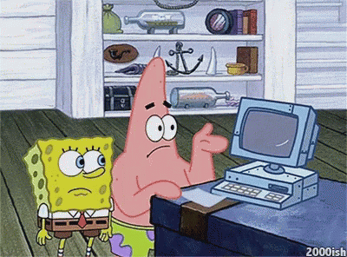
DEMO
Icons from www.flaticon.com

